Slide 1

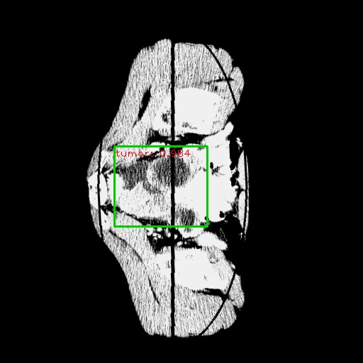
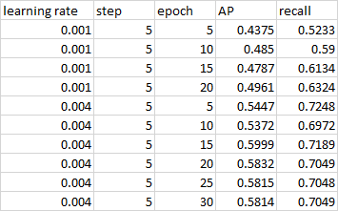
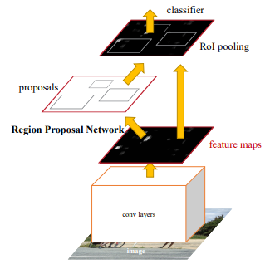
Ovarian Tumor Object Detection using Faster R-CNN
Colin Arscott, Prithvi Kamath, Vineet Sudhir | DS 440 | The Pennsylvania State University
Problem
Annotations
Results
A Doctor’s time is valuable. No current automated process to detect tumors in Ovarian CT Scans.
Plan
To develop a Faster R-CNN model that can take in annotated Images of CT Scans and give us a prediction on Test Data.
Project Overview
Faster R-CNN Topography
Table 1. Presents the results of the R-CNN model with learning rate, max number of epochs, mean Average Precision (AP), and Recall at a 1:1:1 split
Results:
As observed, the Faster R-CNN model performed better at a higher learning rate of 0.004 with max 15 epochs when the train-test-validation split was at an equal amount of 1:1:1. We observed a mAP of ~ 0.6 and a Recall of 0.7189.
When we then switched to a 3:1:1 train-test-validation split in order to allocate more images to the training set. Surprisingly, the mAP of the model decreased overall and only had a max mAP of 0.476 and max Recall of 0.5769 which were in different models with varying learning rate and epoch number.
Collected Image data from Cancer Imaging Archive.
Preprocessed Images to HU, Cut, Pad, and Resize.
Annotated Images indicating Tumors.
Split the images into Train-Validation-Test Sets.
Trained Faster R-CNN and YOLOvR models.
Conducted Hyper Parameter Tuning.
Evaluated on mean Average Precision and Recall.
Documented Findings.
Conclusion
In our project we set out to add some automation to the process of diagnosing ovarian tumors via CT scan. Our plan to accomplish this was by using Convolutional Neural Networks to perform image detection. The detection networks we wanted to compare were YOLOr and Faster R-CNN. We were successful in training models with Faster R-CNN but were unsuccessful with YOLOr
The Faster R-CNN model did not perform within a range that could see real world use. Both the precision and recall were outside of a range that we would feel comfortable seeing use. We believe that this is caused by poor annotations in the dataset. If the dataset were to be re-annotated by a medical professional, I expect that we would see much better results.
Preprocessing
Future Work
Raw Image
Preprocessed Image
Final Image
This Project can be recreated in the future with better results if:
1) A better quality, more reliable, updated, and more versatile dataset could be collected. The dataset of CT scans we collected from Cancer Imaging Archive was old (1989-1999).
The image quality was low, given that the data was from the 80’s and 90’s with older CT machines leading to possible blurry images due to higher exposure making it hard to identify novel features in the images during annotations.
2) Preprocessing the data lead to a lot of information loss, but without the preprocessing we, as untrained in the medical field, would not have been able to identify tumors during annotations.
The presence of a medical expert during the annotation phase would help out greatly in identifying and marking the tumors in the train, validation and test set with perfect accuracy giving us not only a great ground truth, but also dependable images for the training and testing process.
The images need not be preprocessed in such cases since, the medical expert should be able to identify tumors in the images, since they are trained to look at raw CT scans.
Works Cited
Wanderley, D., Ferreira, C., Campilho, A., & Silva, J. (2022, January 10). Ovarian structures detection using convolutional neural networks. Procedia Computer Science. Retrieved May 3, 2022, from https://www.sciencedirect.com/science/article/pii/S1877050921022705
Ren, S., He, K., Girshick, R., & Sun, J. (n.d.). Faster {R-CNN}: Towards Real-Time Object Detection with Region Proposal Networks. Advances in Neural Information Processing Systems. Retrieved from Advances in Neural Information Processing Systems, 2015.
Jianwei Yang, Jiasen Lu, Dhruv Batra, Devi Parikh. A Faster Pytorch Implementation of Faster R-CNN, 2017. Retrieved from https://github.com/jwyang/faster-rcnn.pytorch
Convolutional Neural Networks in the Ovarian Cancer Detection - Piotr A. Kowalski, Jakub Blonairz, Lukaz Chmura, 2022.

